Slide 1
Chapter 1:
The Database Development Process
Modern Database Management
^{10th} Edition
Jeffrey A. Hoffer, Mary B. Prescott,
Heikki Topi
© 2009 Pearson Education, Inc. Publishing as Prentice Hall

Slide 2
Objectives
Definition of terms
Describe system development life cycle
Explain prototyping approach
Explain agile software development approach
Explain roles of individuals
Explain three-schema approach
Explain role of packaged data models
Explain three-tiered architectures
Explain scope of database design projects
Draw simple data models
Notes:
Definition of terms
Describe system development life cycle (SDLC process)
Explain prototyping approach ( a type of rapid software development)
Explain agile software development approach ( another rapid software development methodology)
Explain roles of individuals ( each player in the SDLC process)
Explain three-schema approach
Explain role of packaged data models (a lot of the models you will work with are pre-package such as ERP, CRM systems)
Explain three-tiered architectures
Explain scope of database design projects
Draw simple data models

Slide 3
Enterprise Data Model
First step in database development
Specifies scope and general content
Overall picture of organizational data at high level of abstraction
Entity-relationship diagram
Descriptions of entity types
Relationships between entities
Business rules
Notes:
Example next

Slide 4
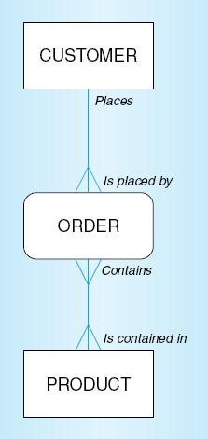
Figure 2-1 Segment from enterprise data model
Enterprise data model describes the high-level entities in an organization and the relationship between these entities
Notes:
Here is an example
Here is an enterprise data model for order fulfilment system
This is a very high level step, where we define entity and relashionship! No Attributes

Slide 5
Information Systems Architecture
(ISA)
Conceptual blueprint for organization’s desired information systems structure
Consists of:
  Data (e.g. Enterprise Data Model–simplified ER Diagram)
  Processes–data flow diagrams, process decomposition, etc.
  Data Network–topology diagram (like Fig 1-7)
  People–people management using project management tools (Gantt charts, etc.)
  Events and points in time (when processes are performed)
  Reasons for events and rules (e.g., decision tables)

Slide 6
Information Engineering
A data-oriented methodology to create and maintain information systems
Top-down planning–a generic IS planning methodology for obtaining a broad understanding of the IS needed by the entire organization
Four steps to Top-Down planning:
  Planning
  Analysis
  Design
  Implementation
Notes:
What are the steps to create or maintain databases?
4 systems to engineer information systems:
Planning
Analysis
Design
Implementation

Slide 7
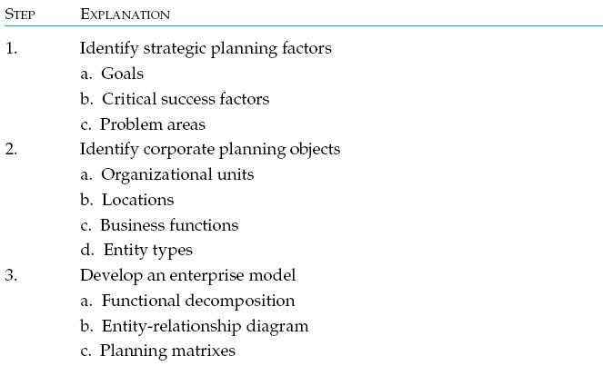
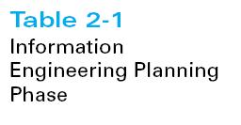
Notes:
Planning stage is divided into 3 parts:
Strategic plans is where the goals and objectives are determine
Planning objects -> identification of entities, who, which department etc
Putting all that information in an E-R diagram and planning matrices

Slide 8
Identify Strategic Planning Factors (Table 2-2)
Organization goals–what we hope to accomplish
Critical success factors–what MUST work in order for us to survive
Problem areas–weaknesses we now have
Notes:
Organization goals–what we hope to accomplish
Critical success factors–what MUST work in order for us to survive.
Problem areas–weaknesses we now have! Perhaps we don’t have enough data, or a missing link, inadequate hardware.

Slide 9
Identify Corporate Planning Objects (Table 2-3)
Organizational units–departments
Organizational locations
Business functions–groups of business processes
Entity types–the things we are trying to model for the database
Information systems–application programs
Notes:
Units -> Finance, HR, Operations, whos involved?
Multi-location vs single location
Within Finance you may have accounting, compliance, etc
Anything also that may be important. For example we are trying to develop an order fulfilment… The question we ask is what are we ordering? This leads us to products.

Slide 10
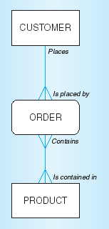
Develop Enterprise Model
Functional decomposition
  Iterative process breaking system description into finer and finer detail
Enterprise data model
Planning matrixes
  Describe interrelationships
  between planning objects
Notes:
Last step is to develop an E-R model

Slide 11
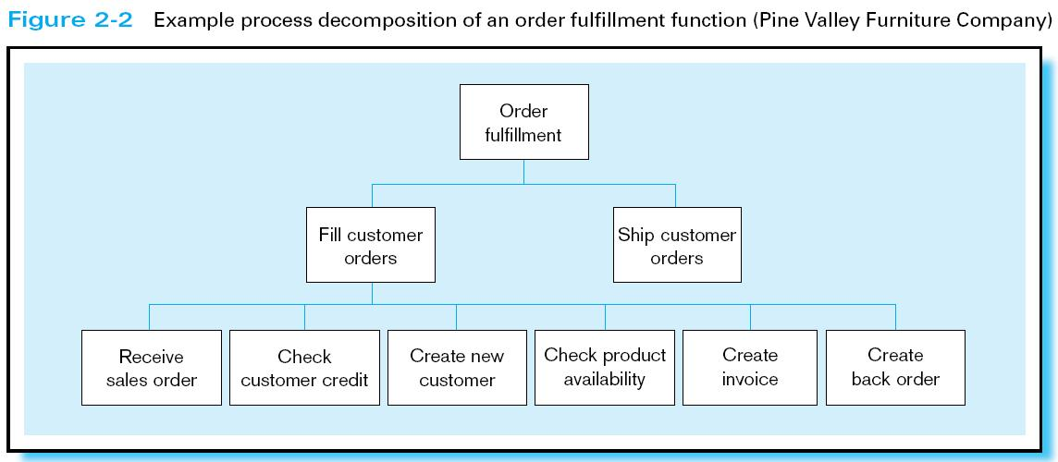
Notes:
Example of process decomposition:
This is not an E-R diagram… we are breaking the function of the systems into small sub-functions

Slide 12
Planning Matrixes
Describe relationships between planning objects in the organization
Types of matrixes:
  Location-to-function
  Unit-to-function
  IS-to-data entity
  Supporting function-to-data entity
  IS-to-business objective

Slide 13
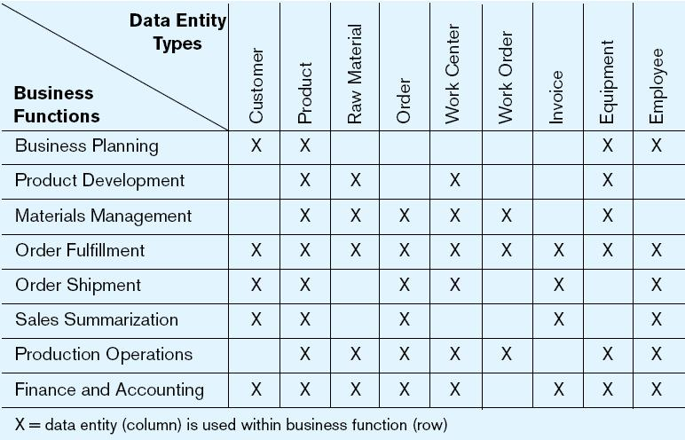
Example Business Function-to-Data Entity Matrix (Fig. 2-3)
Notes:
Here is an example of Business Function Matrices.
Left side of the screen we have the business functions, on the top we have entitie types. Customer, product orders.
Why we don’t have an X for materials management and Customer. There is no relationship, materials can be managed even if the company has no customer.

Slide 14
Two Approaches to Database and IS Development
Traditional SDLC
  System Development Life Cycle
  Detailed, well-planned development process
  Time-consuming, but comprehensive
  Long development cycle
Prototyping
  Rapid application development (RAD)
  Cursory attempt at conceptual data modeling
  Define database during development of initial prototype
  Repeat implementation and maintenance activities with new prototype versions
Notes:
Traditional SDLC process, such as WaterFall methodolody

Slide 15
Systems Development Life Cycle
(see also Figures 2.4, 2.5)
Planning
Analysis
Logical Design
Physical Design
Implementation
Maintenance
Notes:
6 steps in a traditional SDLC process for Database

Slide 16
Systems Development Life Cycle
(see also Figures 2.4, 2.5) (cont.)
Planning
Purpose–preliminary understanding
Deliverable–request for study
Planning
Analysis
Logical Design
Physical Design
Database activity–
enterprise modeling and early conceptual data modeling
Implementation
Maintenance
Notes:
At the end we want to have a high level entities, what they do. The business functions and the matrices.

Slide 17
Systems Development Life Cycle
(see also Figures 2.4, 2.5) (cont.)
Purpose–thorough requirements analysis and structuring
Deliverable–functional system specifications
Planning
Analysis
Analysis
Logical Design
Physical Design
Database activity–thorough and integrated conceptual data modeling
Implementation
Maintenance
Notes:
Analysis of the requirement. Creation of a functional system spec document.

Slide 18
Systems Development Life Cycle
(see also Figures 2.4, 2.5) (cont.)
Purpose–information requirements elicitation and structure
Deliverable–detailed design specifications
Planning
Analysis
Logical Design
Logical Design
Physical Design
Database activity–
logical database design (transactions, forms, displays, views, data integrity and security)
Implementation
Maintenance
Notes:
Detailed design spec
Logical db design with all the attributes

Slide 19
Systems Development Life Cycle
(see also Figures 2.4, 2.5) (cont.)
Purpose–develop technology and organizational specifications
Deliverable–program/data structures, technology purchases, organization redesigns
Planning
Analysis
Logical Design
Physical Design
Physical Design
Database activity–
physical database design (define database to DBMS, physical data organization, database processing programs)
Implementation
Maintenance
Notes:
Design the data structures. Create the physical model. Technology specific

Slide 20
Systems Development Life Cycle
(see also Figures 2.4, 2.5) (cont.)
Purpose–programming, testing, training, installation, documenting
Deliverable–operational programs, documentation, training materials
Planning
Analysis
Logical Design
Physical Design
Database activity–
database implementation, including coded programs, documentation, installation and conversion
Implementation
Implementation
Maintenance
Notes:
Coding, interfaces. stored procedure, functions

Slide 21
Systems Development Life Cycle
(see also Figures 2.4, 2.5) (cont.)
Planning
Purpose–monitor, repair, enhance
Deliverable–periodic audits
Analysis
Logical Design
Physical Design
Database activity–
database maintenance, performance analysis and tuning, error corrections
Implementation
Maintenance
Maintenance
Notes:
It is never done, fix issues, performance tuning etc.

Slide 22
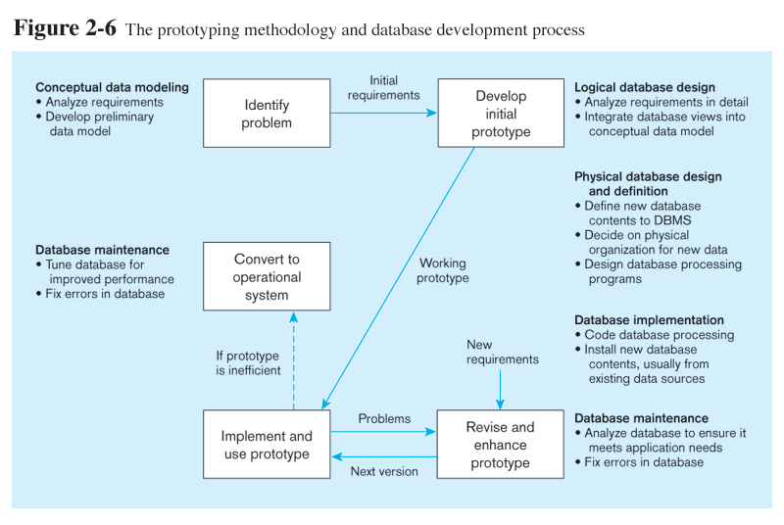
Prototyping Database Methodology
(Figure 2.6)
Notes:
In prototyping methodology, it is much faster!
Next slide, next steps

Slide 23
Prototyping Database Methodology
(Figure 2.6) (cont.)
Notes:
Same as analysis, identify the problem, what are the entities that you need to create and the relashionship

Slide 24
Prototyping Database Methodology
(Figure 2.6) (cont.)
Notes:
Step 2: you start creating the logical design, turn that into a physical model, and implement your code

Slide 25
Prototyping Database Methodology
(Figure 2.6) (cont.)
Notes:
Revise until all issues are resolved. There typically introduction of new features that you missed initally

Slide 26
Prototyping Database Methodology
(Figure 2.6) (cont.)

Slide 27
CASE
Computer-Aided Software Engineering (CASE)–software tools providing automated support for systems development
Three database features:
  Data modeling–drawing entity-relationship diagrams
  Code generation–SQL code for table creation
  Repositories–knowledge base of enterprise information

Slide 28
Packaged Data Models
Model components that can be purchased, customized, and assembled into full-scale data models
Advantages
  Reduced development time
  Higher model quality and reliability
Two types:
  Universal data models
  Industry-specific data models
Notes:
Most of times when you get a job you will be working with packaged data models such as an ERP system

Slide 29
Managing Projects
Project–a planned undertaking of related activities to reach an objective that has a beginning and an end
Involves use of review points for:
  Validation of satisfactory progress
  Step back from detail to overall view
  Renew commitment of stakeholders
Incremental commitment–review of systems development project after each development phase with rejustification after each phase

Slide 30
Managing Projects: People Involved
Business analysts
Systems analysts
Database analysts and data modelers
Users
Programmers
Database architects
Data administrators
Project managers
Other technical experts
Notes:
Depending on the company you may have more or less folks involved
BA/SA same person
Data architects and Analysts may be the same person

Slide 31
Database Schema
External Schema
  User Views
  Subsets of Conceptual Schema
  Can be determined from business-function/data entity matrices
  DBA determines schema for different users
Conceptual Schema
  E-R models
Internal Schema
  Logical structures
  Physical structures

Slide 32
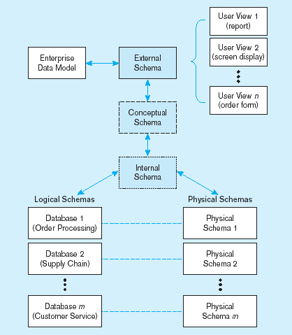
Figure 2-7 Three-schema architecture
Different people have different views of the database…these are the external schema
The internal schema is the underlying design and implementation
Notes:
Three schema architecture is nothing but how database is viewed from different perspective
Ende users: data is viewed in a report or in a screen of an app. External schema
Conceptual schema -> that’s the logical organization of databases/business units
Physical schema is the actual implementation of schemas.

Slide 33
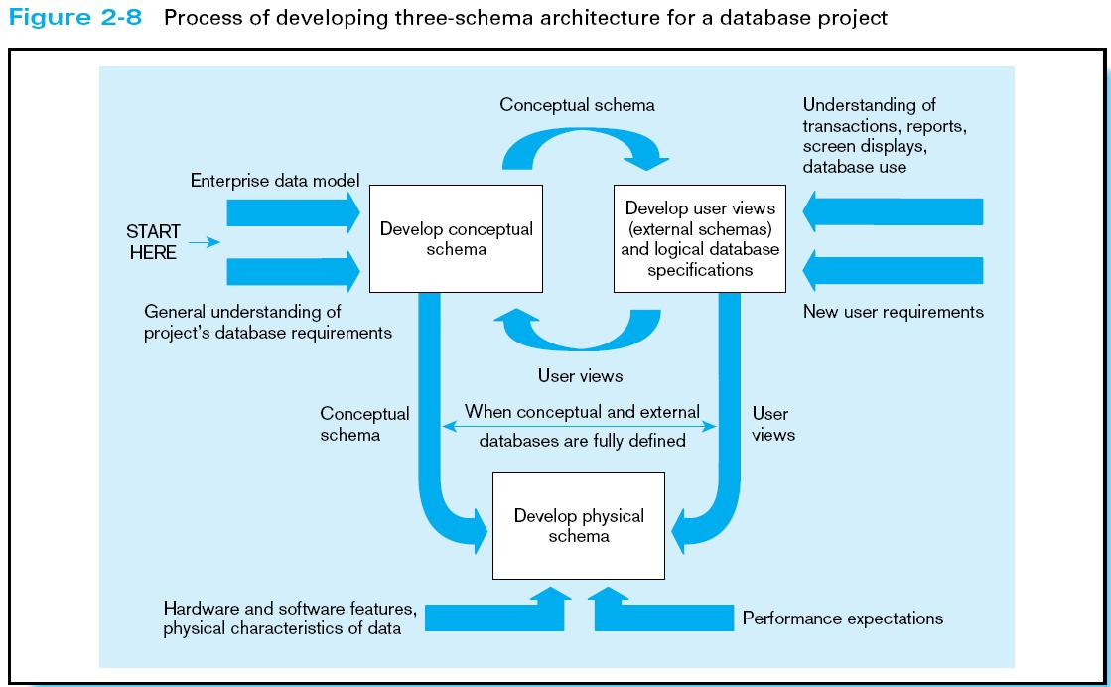
Notes:
Remove
The process of developing your arch, the three schemas are implemented.
Developing E-R diagram, you are developing the conceptual schema. Developing user views on how they inferace with the data is external schema
And of course, physical schema is the actual implementation in the database.

Slide 34
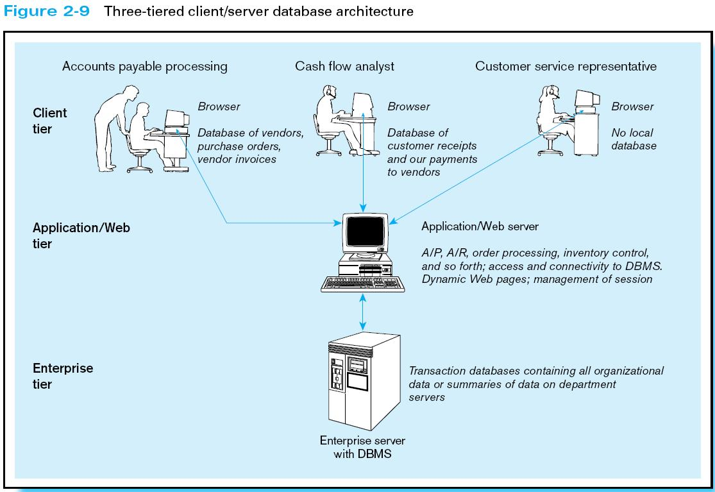
Notes:
Example of 3 tier client-server archicture.
That’s one of the most popular architecture. Often times, there is a four tier where there is a web service / data access layer
S

Slide 35
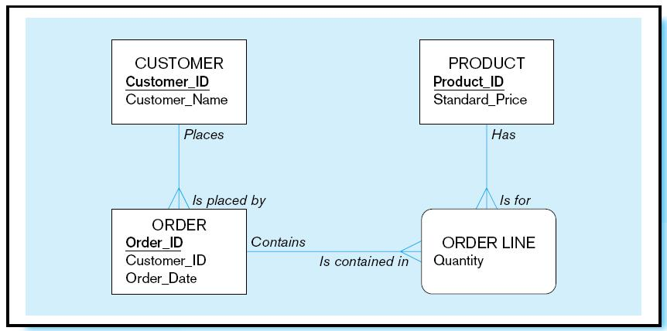
Pine Valley Furniture
Segment of project data model (Figure 2-11)

Slide 36
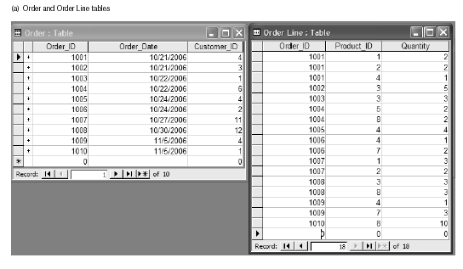
Figure 2-12 Four relations (Pine Valley Furniture)

Slide 37
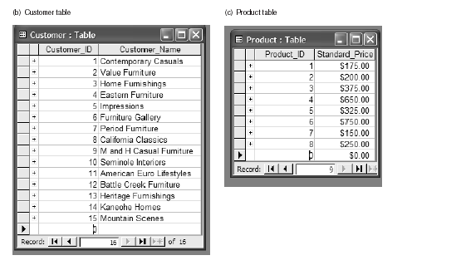
Figure 2-12 Four relations (Pine Valley Furniture) (cont.)

